Slide 1
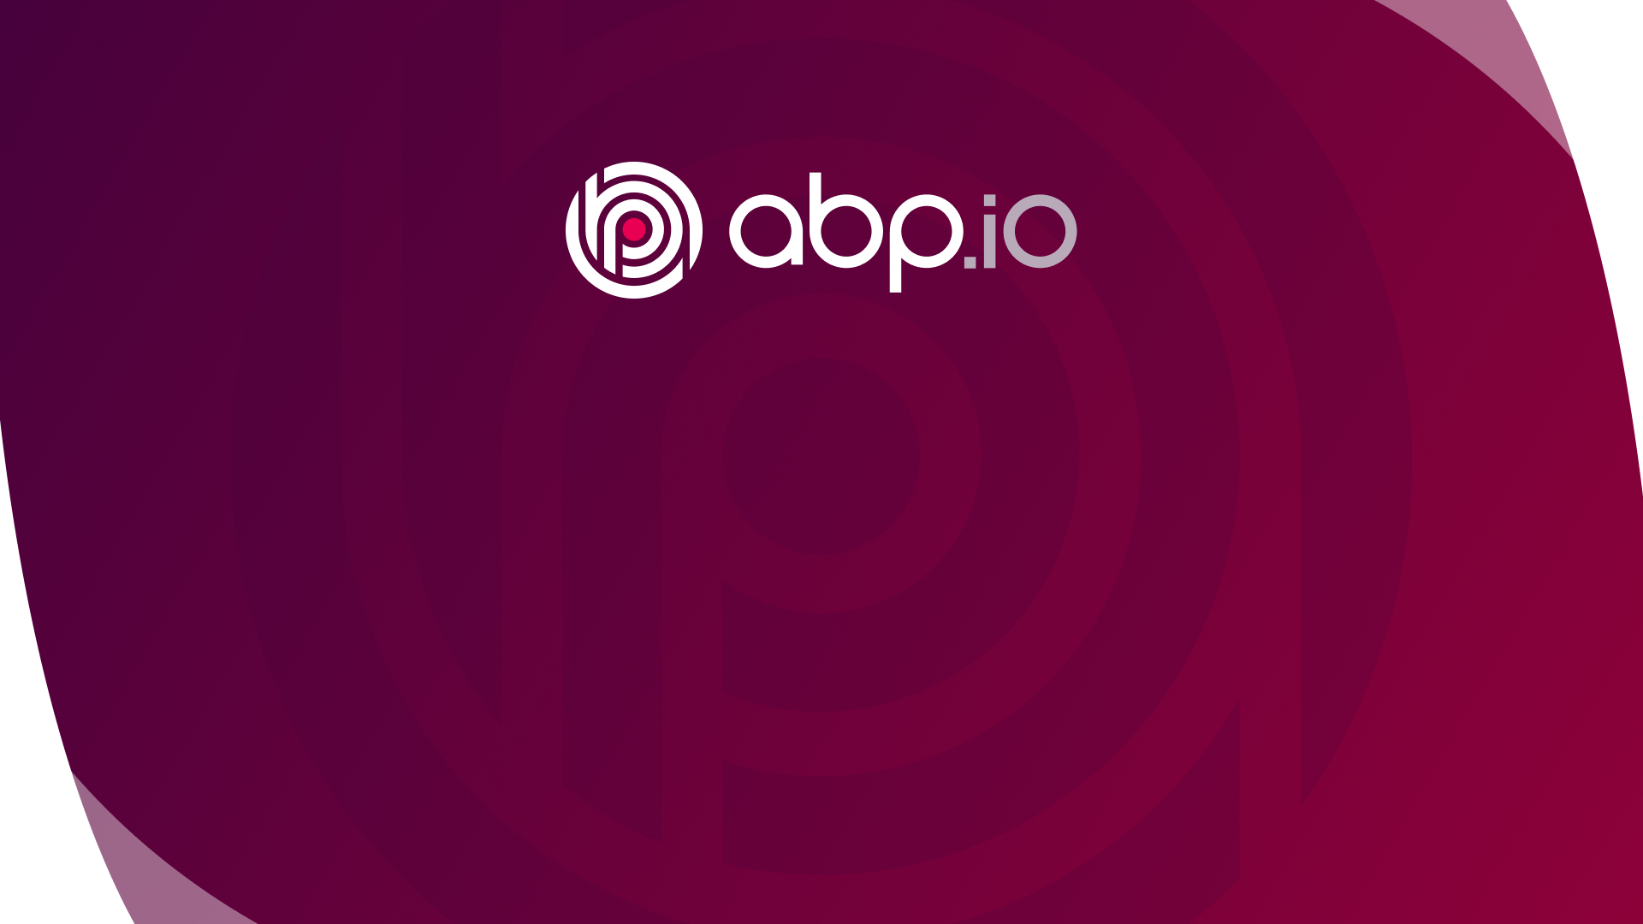
Exploring the ABP Framework
github.com/abpframework
Halil İbrahim Kalkan

Slide 2
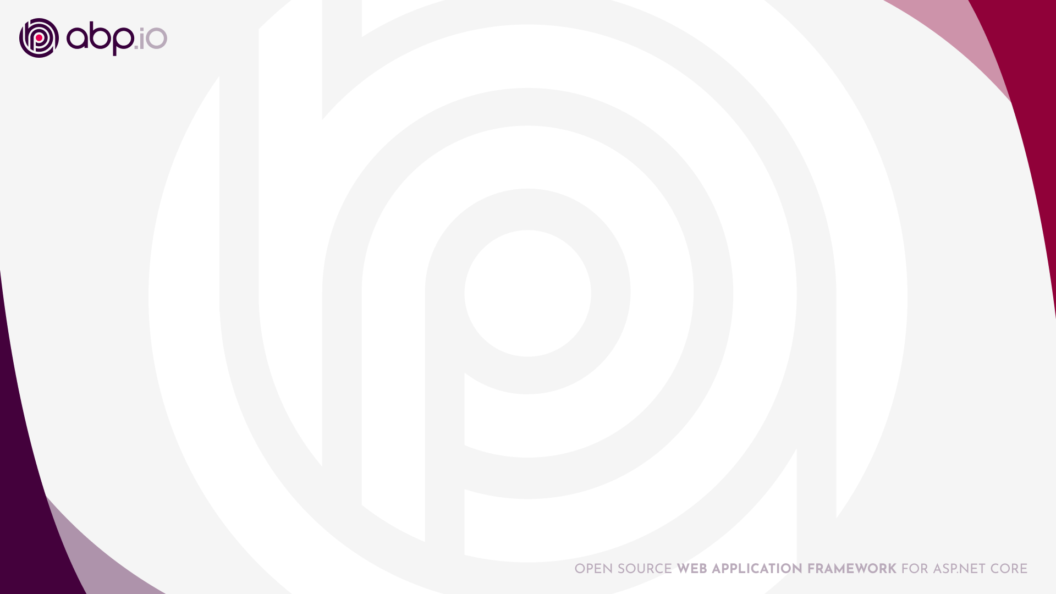
Why we need an application framework?
Setting up the architecture
Prepare a robust and maintainable solution structure
Explore and adapt the essential libraries and tools
Setup the test infrastructure
Prepare the deployment configuration
Keep the solution up to date
Building the infrastructure
DRY! Automate cross-cutting concerns & repeating code
Abstractions and integrations to external tools and systems
Base classes and helpers to implement the architecture
Make all reusable? Or copy for new projects?
The standards
Determining the coding standards / conventions
Documenting the architecture and infrastructure
Your Application
(plain) ASP.NET Core

Slide 3
Why we need an application framework?
Common non-business requirements
Permission and authorization system, audit logging
Multi-tenancy, soft-delete, BLOB storing
Working with multiple time zones and languages
Background jobs, feature toggling
Common application functionalities
UI layout & theme
Login, register, forgot password, two-factor authentication…
User, role and permission management
Your Application
(plain) ASP.NET Core

Slide 4

What is the ABP Framework?
ABP fills the gap between the plain ASP.NET Core and enterprise software requirements.
Offers a modern and maintainable software architecture.
Provides the necessary infrastructure, tooling and documentation implement that architecture.
A great community contributes and discusses that architecture!
Working on the latest .NET..!
Your Application
(plain) ASP.NET Core

Slide 5
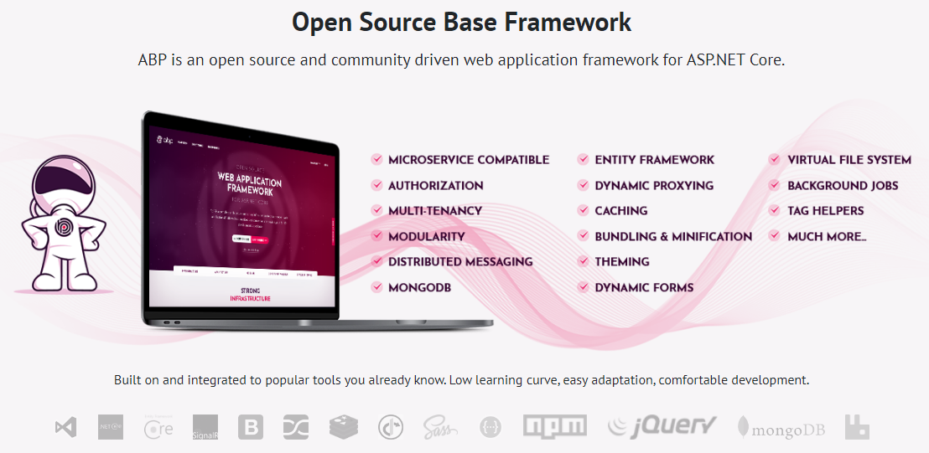

Slide 6
The architecture
Domain Driven Design
& Layered Solution
Modular
Multi-Tenancy (SaaS infrastructure)
Microservice ready

Slide 7


UI / Database options

Slide 8

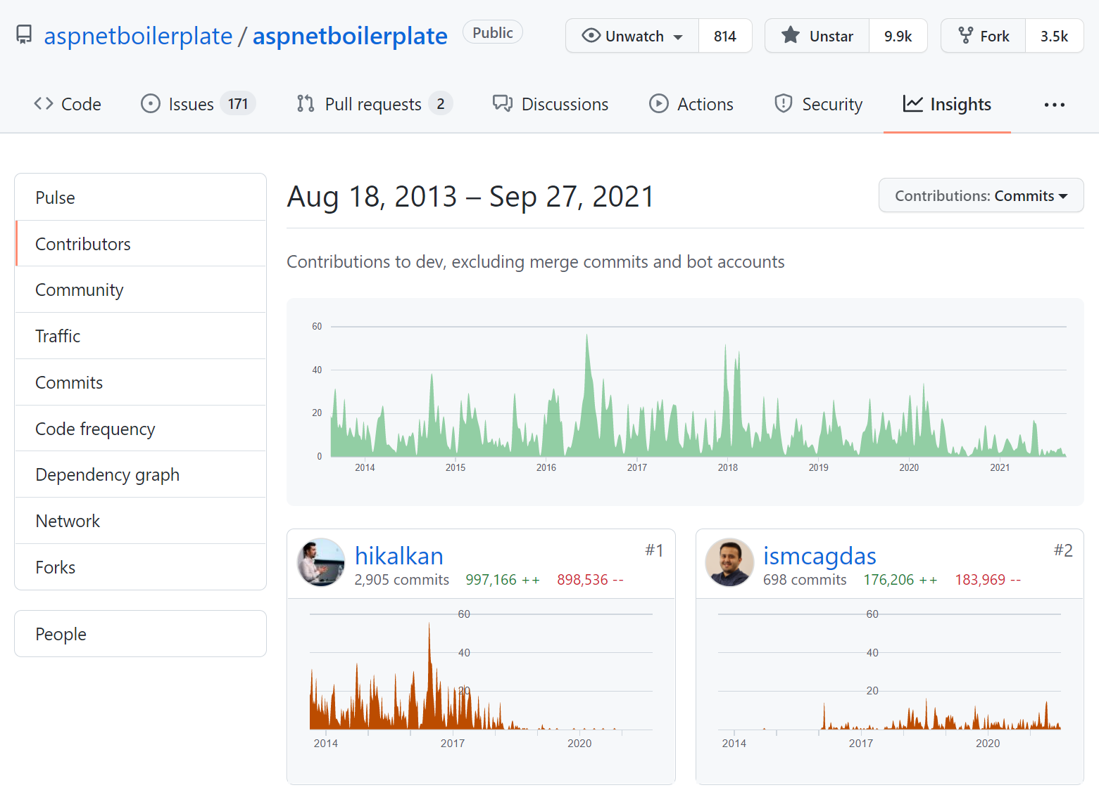
History of the ABP Framework
8 years of continuous development
167 contributors
10K stars on GitHub
5M+ downloads on NuGet

Slide 9
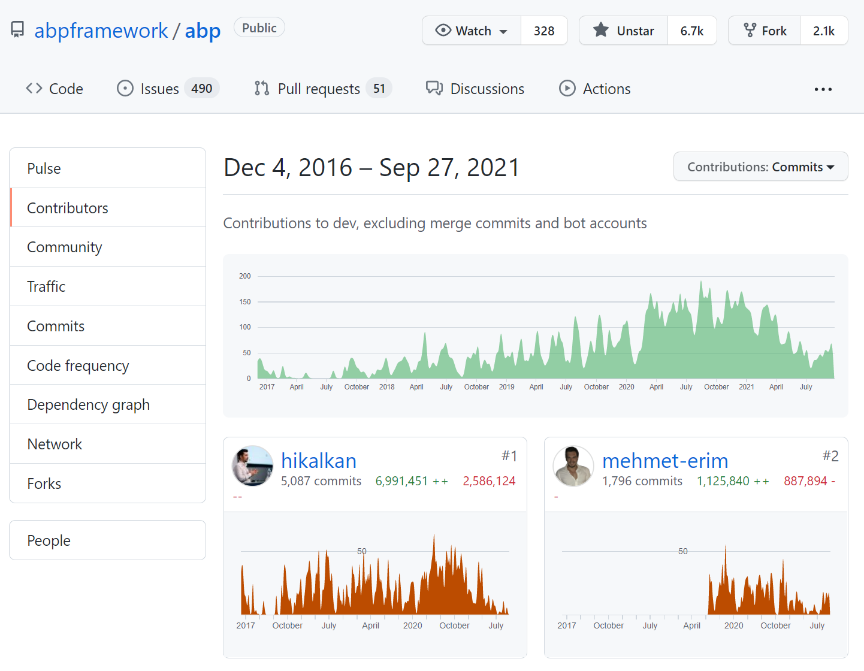
History of the ABP Framework
5 years of development
210 contributors
6.7K stars on GitHub
2.1M downloads on NuGet

Slide 10

ABP Highlights

Slide 11
Client to Server Communication
Blazor Component
ABP Dynamic C# Client Proxy
Method call -> REST conversion
* Endpoint discovery, authentication header, culture header, versioning
* JSON serialization / deserialization
* Exception handing
REST call
ABP Conventional Controller
ABP middleware & filters
* Validation
* Authorization (permission based)
* Exception handing
* Audit logging
* Unit of work / database connection and transaction management
Application Service

Slide 12
Client to Server Communication
DEMO

Slide 13
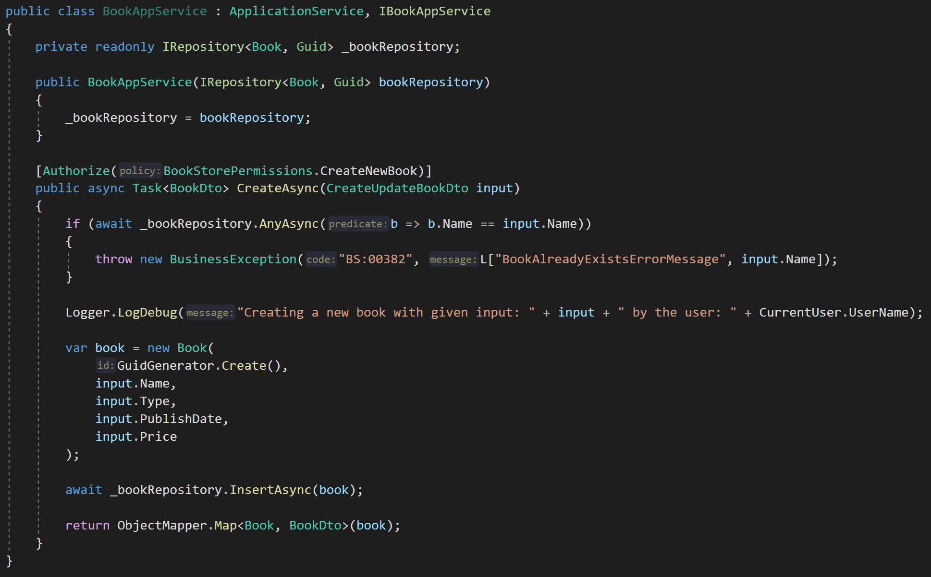
DDD Base Classes
DI Auto-Register
Generic Repositories
Authorization / Permissions
Auto Validation
Unit Of Work (Transaction Management)
Auto Audit Logging
Localization
Exception Management & Handling
ICurrentUser
ISettingProvider
IFeatureChecker
IGuidGenerator …
Object2Object Map

Slide 14

Inter-microservice messaging
Microservice A
Microservice B
event
Message Broker
(RabbitMQ, Kafka, etc)
event
application data
application data
re-connect
re-try
publish/subscribe
the transaction problem!

Slide 15
Inter-microservice messaging with ABP
Microservice A
Microservice B
event
event
ABP Event Bus
Message Broker
(RabbitMQ, Kafka, etc)
ABP Event Bus
application data
application data
re-connect
re-try
publish/subscribe
background workers
auto-events
distributed locking
outbox/inbox
outbox/inbox

Slide 16
Inter-microservice messaging with ABP
DEMO

Slide 17
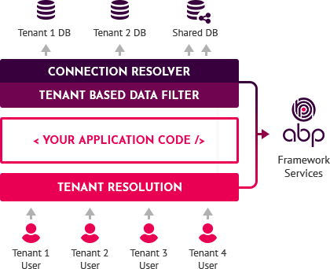
Multi-Tenancy
Multi-tenant infrastructure
Tenant determination, auto data isolation, dynamic database selection, tenant basis configurations… etc.
Multi-tenancy unaware applications!
Pre-built tenant management module to create and manage your tenants!

Slide 18
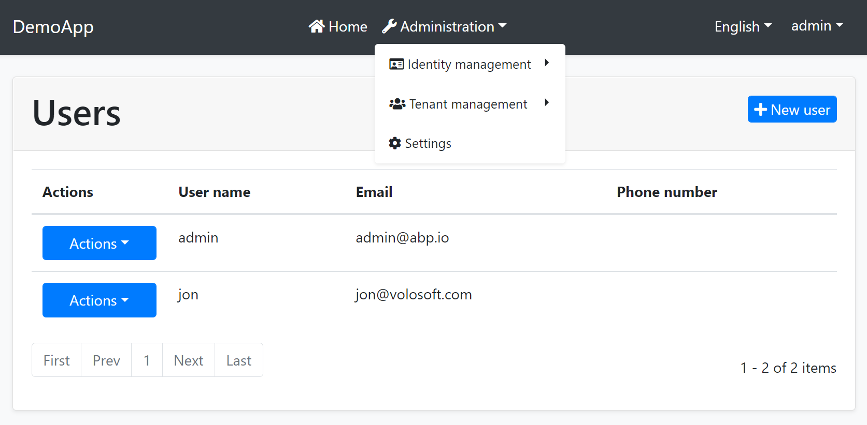
The theming system
Common base libraries
Pre-defined layouts
Header, toolbar, menu, widget…
Bundling & minification system
Overriding/replacing components
Themes a NuGet/NPM packages

Slide 19
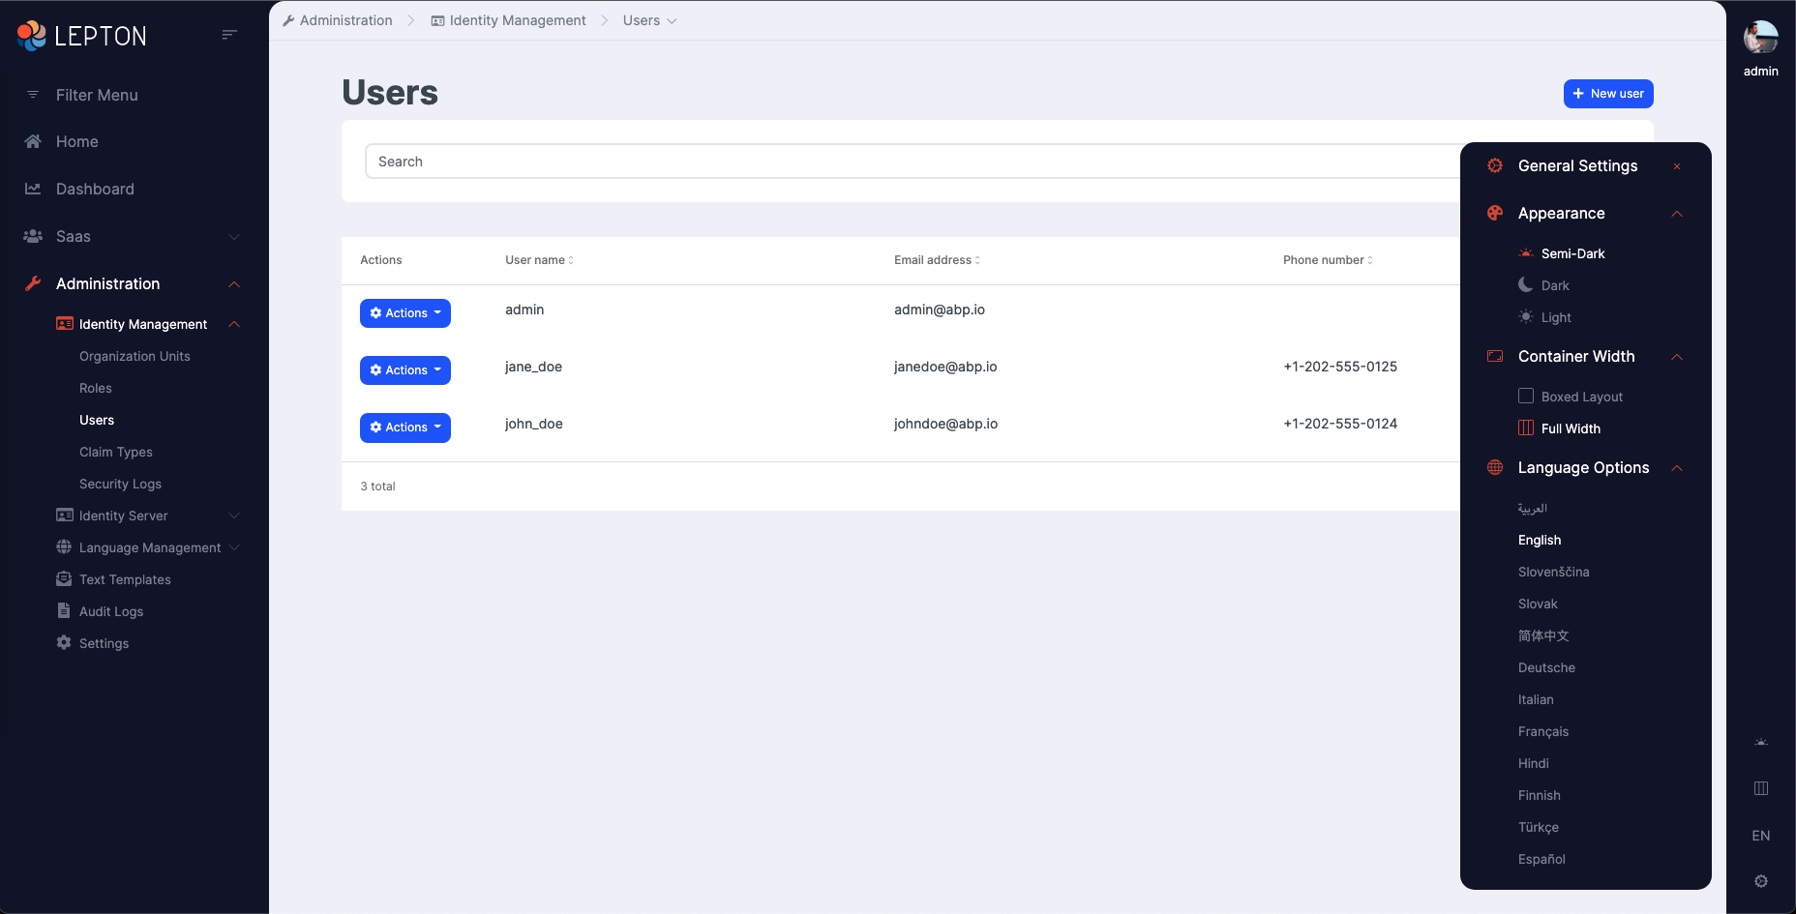

Slide 20
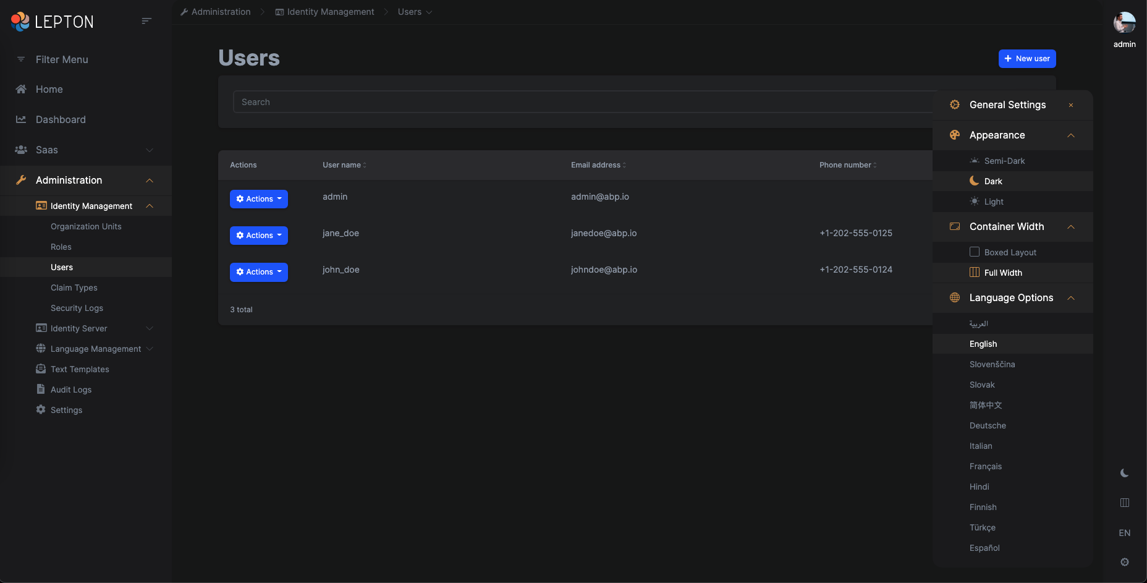

Slide 21
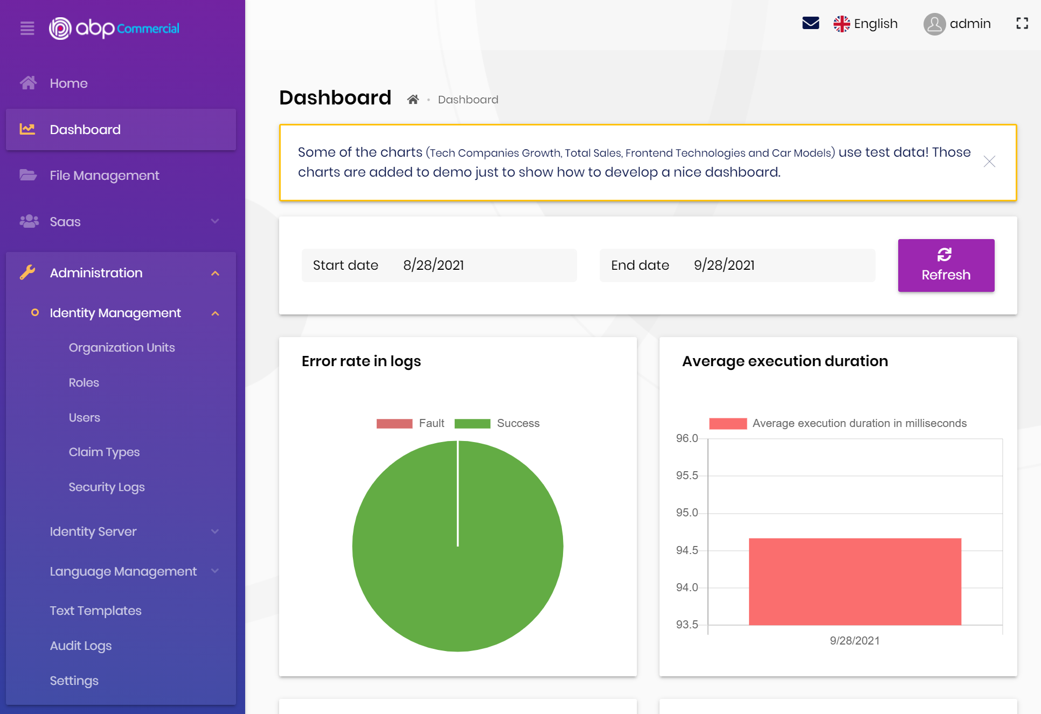

Slide 22
Multi-tenancy & theming
DEMO

Slide 23
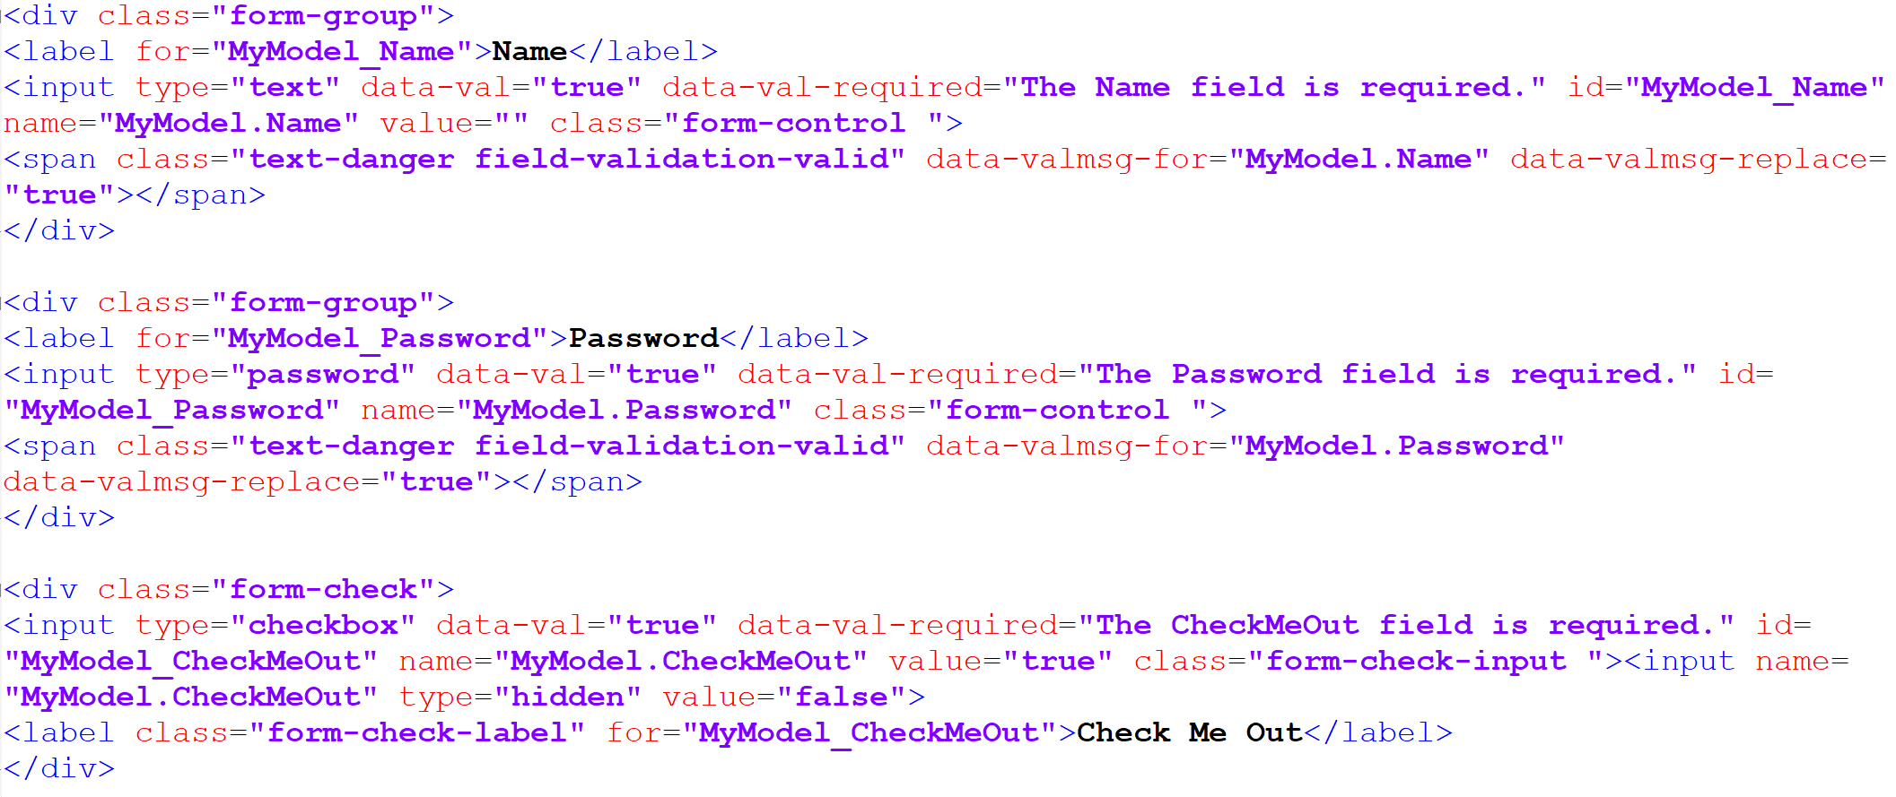
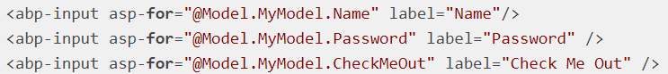
ABP Input Tag Helpers

Slide 24
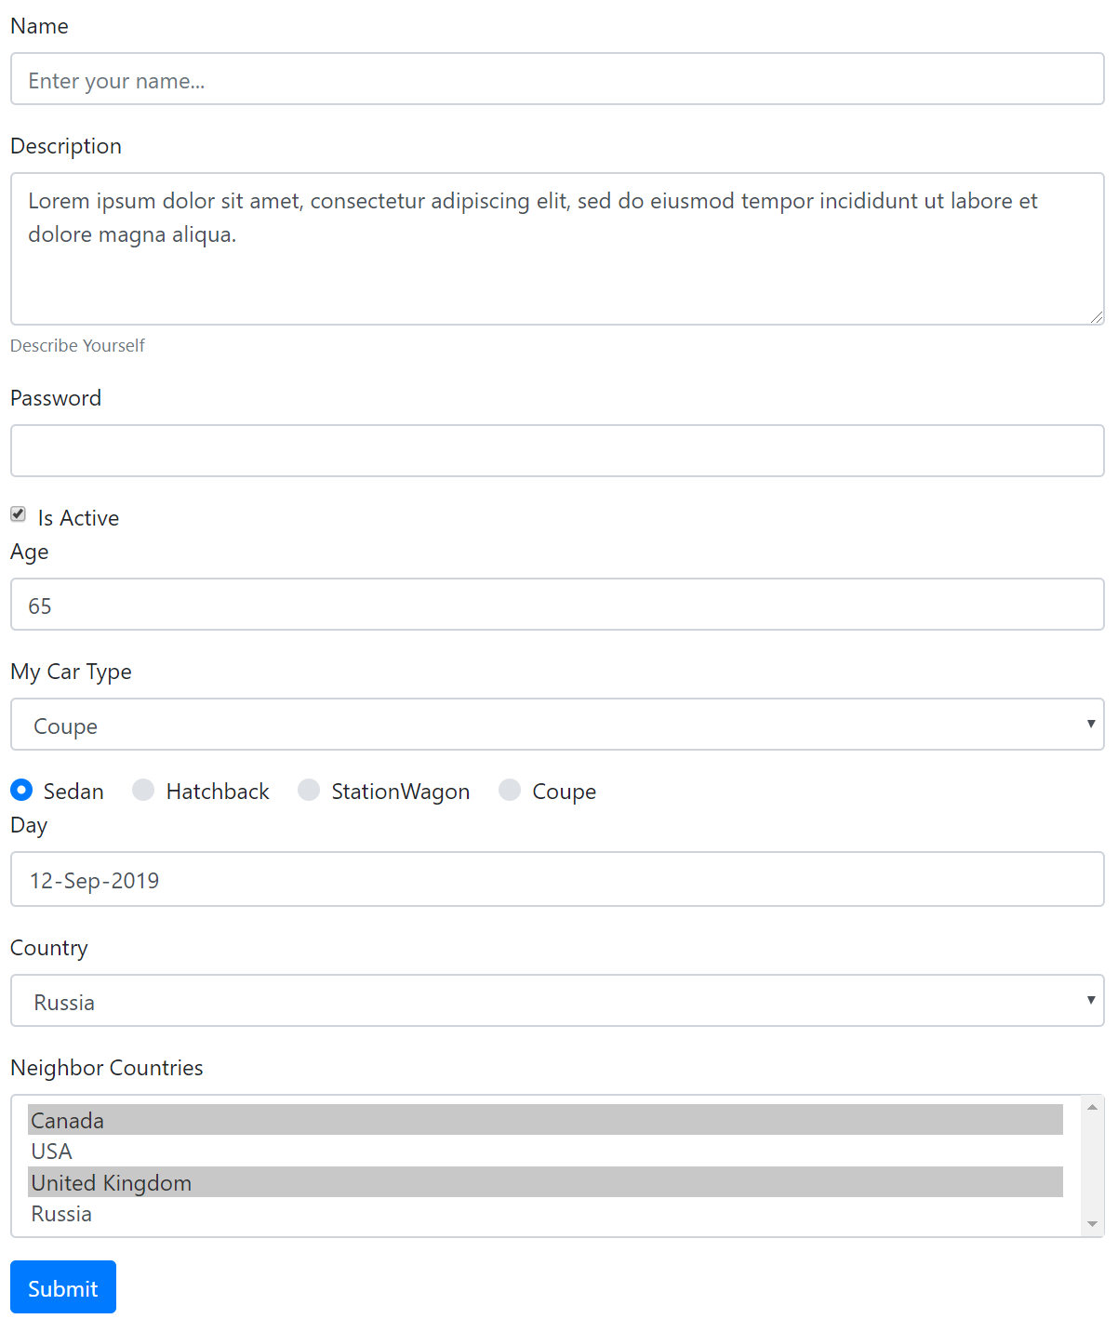
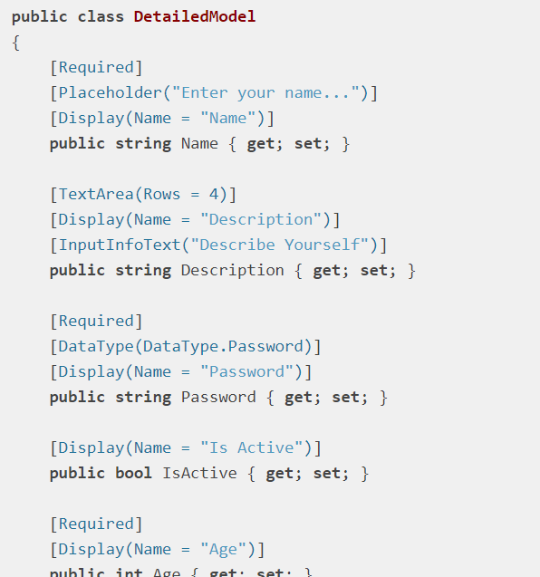
ABP Dynamic Forms
Validation &
Localization

Slide 25
Features and features…
Object to object mapping (with AutoMapper by default)
Soft-delete pattern & generic data filtering system
BLOB Storing (with many providers)
Background job queue system
Email / SMS sending abstractions
Text templating
Virtual file system
Caching, Settings, Data seeding, Global features, …etc.

Slide 26
What’s coming with ABP v5.0
.NET 6.0
Bootstap 5.x
Distributed event bus: outbox/inbox
Static C# and JavaScript client proxies
New theme: Lepton X
Microservice example solution: eShopOnABP

Slide 27
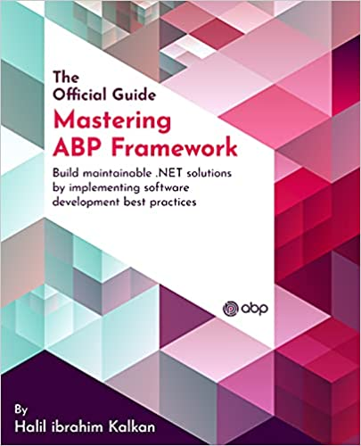
Learning resources
SHOW ME!

Slide 28
Questions..?
follow the ABP Framework
www.abp.io
github.com/abpframework
twitter.com/abpframework

Slide 29
TODO
…

